Slide 1




Protecting public health through comprehensive radon monitoring and dosimetry in urban Tbilisi
Third Annual Poisoning and Trauma Injury Conference | Tbilisi, Georgia, July 15-16, 2025
Natia Beriashvili, Maia Avtandilashvili, Giorgi Giorganashvili,
Kakha Gorgadze, Magda Metskvarishvili, Medea Burjanadze, George Tabatadze
Institute Wave, Georgian Technical University, Tbilisi, Georgia
Notes:
The work was supported by Shota Rustaveli National Science Foundation of Georgia (SRNSFG), FR-24-2178, Protecting public health through comprehensive radon monitoring and dosimetry in urban Tbilisi
დავამატო რადონის

Slide 2

Outline
Introduction and motivation
Previous studies
Project overview
Future directions
Notes:
Introduction and motivation:
What is radon?
The health impacts of radon exposure
Importance of radon monitoring (Public safety, environmental and regulatory needs.)
Long-term and short-term monitoring (a brief overview of passive and active detection).
European standards (here we will briefly mention the standards of other countries).
standards in Georgia (emphasizing the new law and limitations).
Current challenges: I am not sure where to put this, can be merged with project-specific context.
Previous achievements (2008 maps, articles, PhD thesis, 3 key projects, as a one slide)
Monitoring in kindergartens (ALGADE – detectors).
Public awareness assessment (STEAM project).
Engagement with existing detection systems (Radosys).
Project overview & study aim
About the project (grant holder, team, duration)
Study motivation: Since we have a lot of mountains regions, artesian waters (sulfur baths) and an active hydrogeological situation, and many people live in half-basements.
Short-term aims (website, seismic maps, data collection – shown graphically).
Long-term aim (overall vision – shown as flowchart).
Final goal (support EU integration – show EU map and need for alignment)

Slide 3

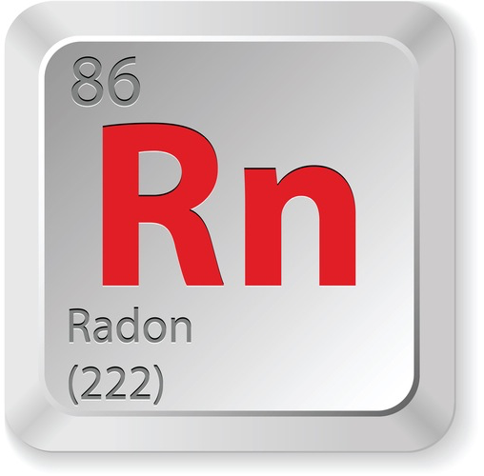
What is Radon?
Radon is a colorless, odorless, and tasteless radioactive gas.
Radon gas is generated in the soil through the decay of uranium in rocks.
Isotope | Surce Series | Half-life
Rn-222 | Uranium-238 | ~3.8 days
Rn-220 | Thotium-232 | ~ 55 sec
Rn-219 | Uranium-235 | ~4 sec
Notes:
Radon is a naturally occurring radioactive gas produced from the decay of uranium in rocks and soil. It is invisible, odorless, and tasteless, and it can accumulate in enclosed spaces like homes and buildings.

Slide 4
What is Radon?
Due to its chemical inertness, radon relatively easily leaves the mineral and enters groundwater, underground natural gases, and air.

Slide 5
What is Radon?
After reaching the ground surface, radon quickly dissolves in the air and its concentration drops sharply.

Slide 6
What is Radon?
Sometimes radon enters buildings through the foundation, where its concentration can reach dangerous levels.

Slide 7


Radon Monitoring
Detector
Radon testing is the only way to determine how harmful the air in your home is.
Notes:
Font increase for each slides

Slide 8
Radon Detection
Feature | Passive Detection | Active Detection
Principle | collects radon or decay products over time | Continuously measures radon
Examples | Charcoal canisters, alpha track detectors | Electronic radon monitors (e.g., ionization chambers)
Power Source | Not required | Requires electricity
Data Output | Cumulative exposure; no time resolution | Real-time or time-resolved data
Use Case | Long-term home monitoring, low-cost surveys | Short-term studies, workplace safety, research applications
Advantages | Inexpensive, simple, no power or maintenance needed | Immediate results, detailed temporal data
Limitations | Results delayed, cannot track rapid fluctuations | More expensive, requires calibration and maintenance
Notes:
xelsawypoebi (ra gvaq chven) radoon AI da rac gvinda

Slide 9

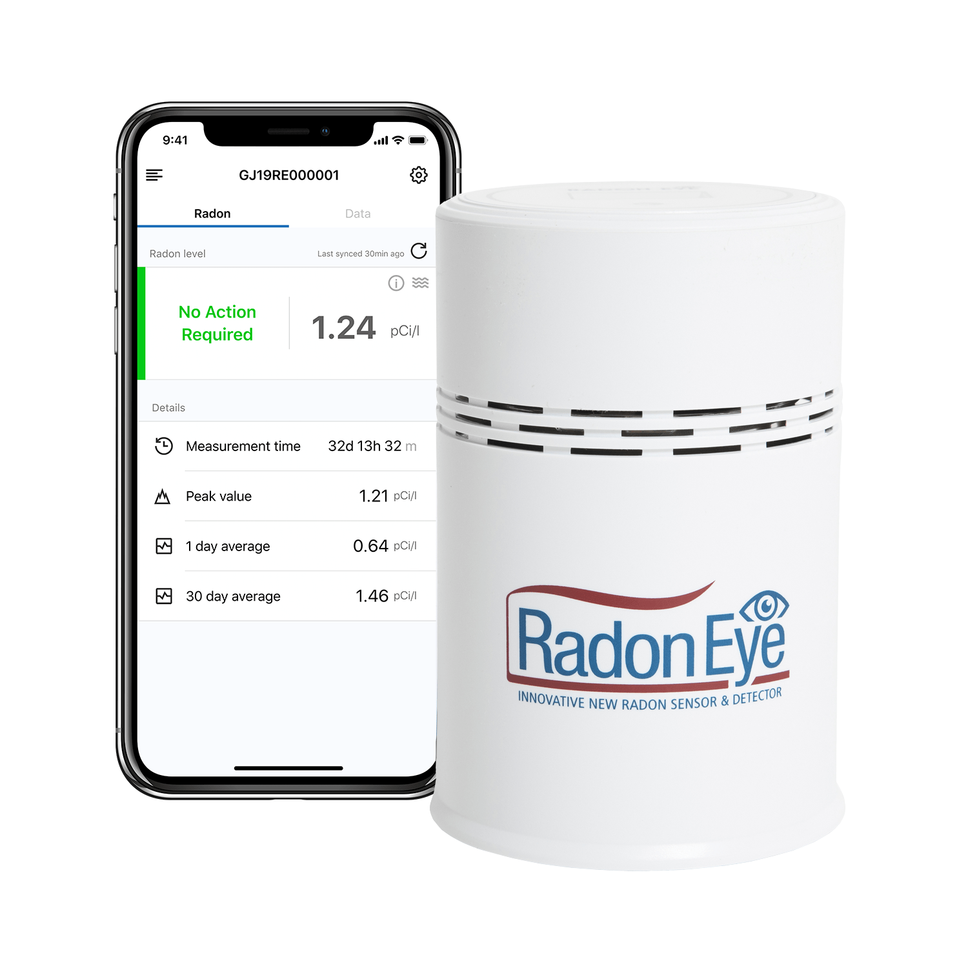
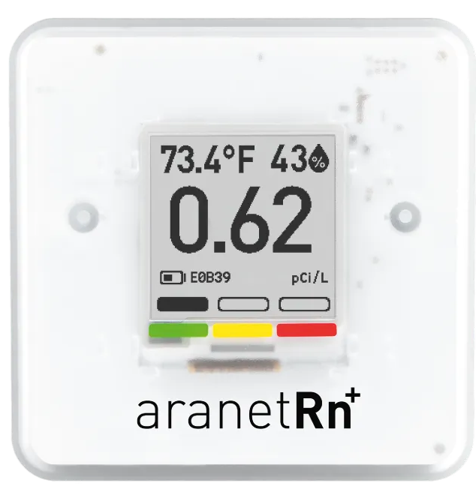
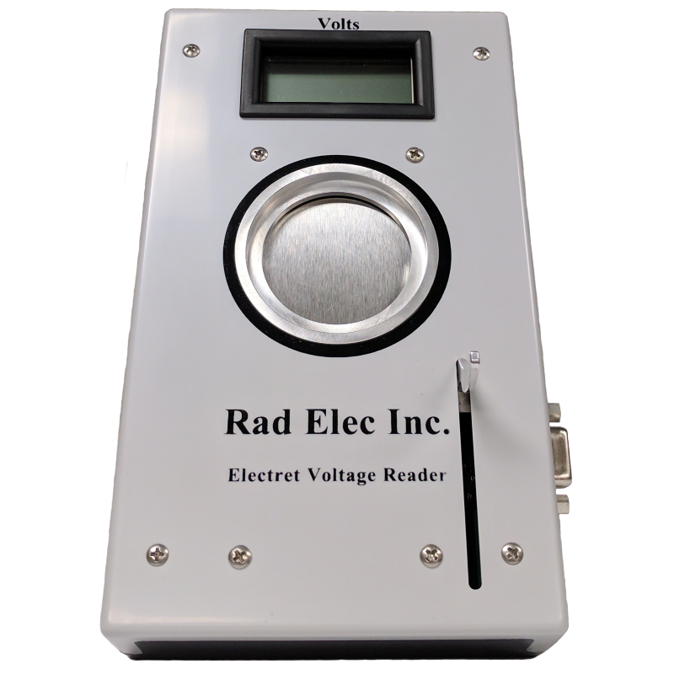
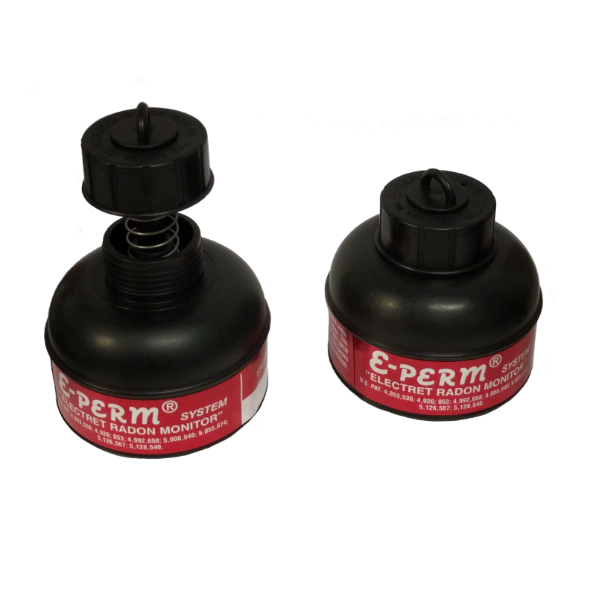
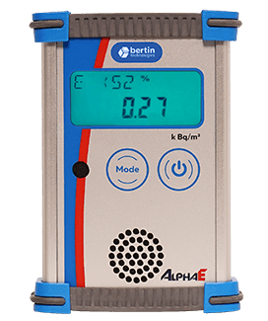
Radon Detectors
Ecosense RD200W
RadonEye
Aranet Radon Plus
AlphaE: ultra-small radon monitor
E-PERM® system: SPER-1E Voltage Reader, electrets, and chambers
Notes:
xelsawypoebi (ra gvaq chven) radoon AI da rac gvinda

Slide 10
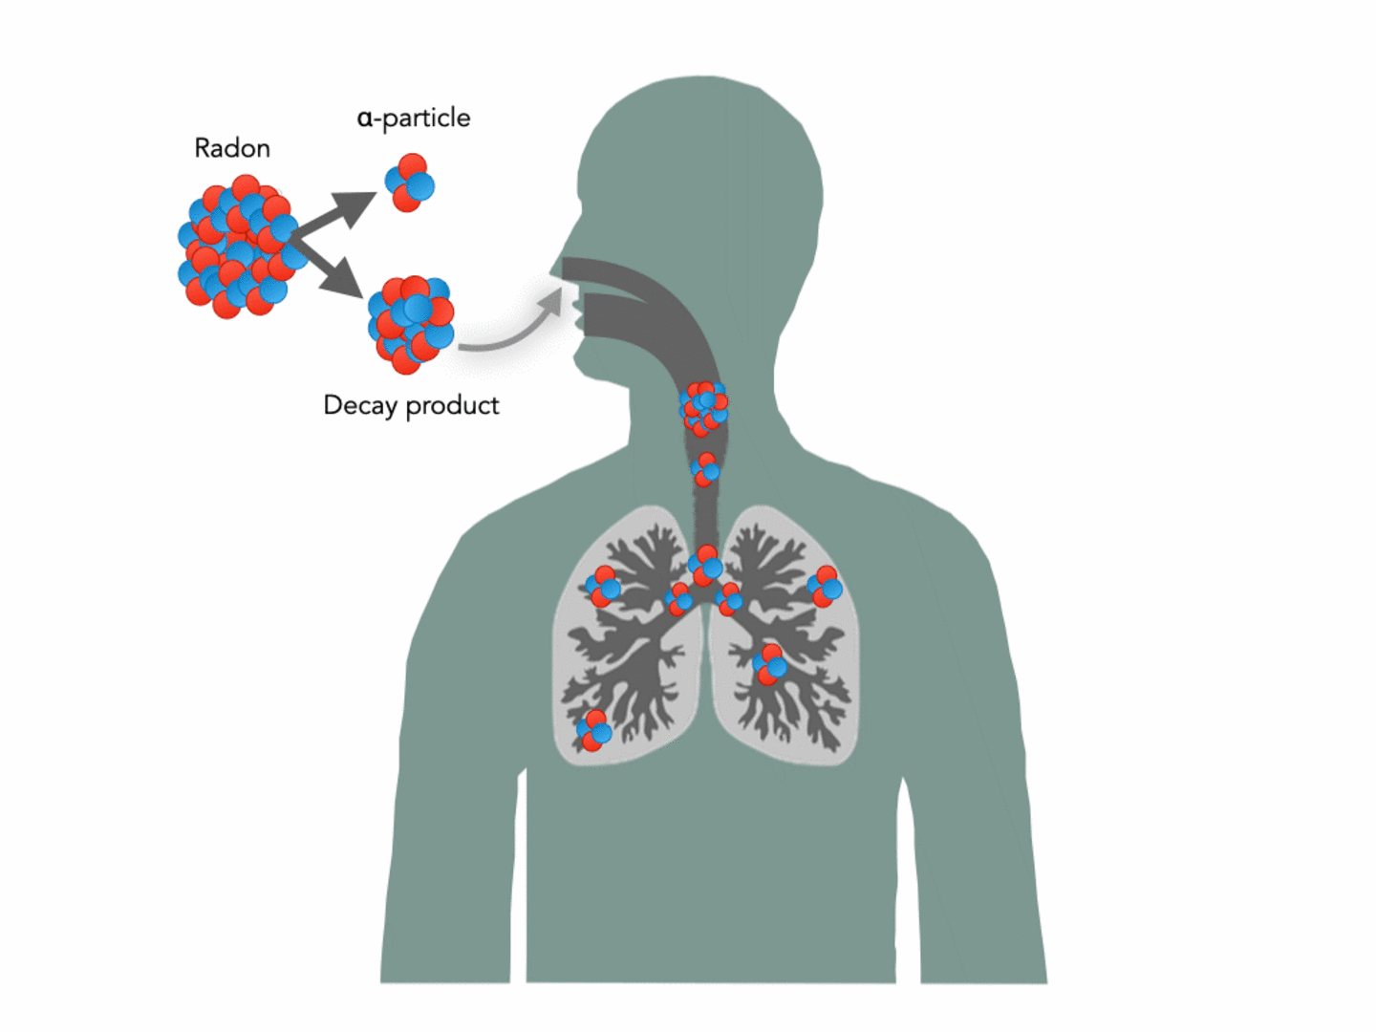



Radon-Induced Health Risks
Detector
300 ბკ/მ³
400 ბკ/მ³
200 ბკ/მ³
100 ბკ/მ³
50 ბკ/მ³
0 ბკ/მ³
500 ბკ/მ³
10 ბკ/მ³
20 ბკ/მ³
30 ბკ/მ³
Figure from Helmholtz Centre for Heavy Ion Research
40 ბკ/მ³
Radon and its decay products are inhaled into the lungs, where they emit alpha particles as they decay. These particles can cause localized damage to lung tissue, increasing the risk of lung cancer.
Lung cancer risk increases when indoor radon concentrations exceed 100 Bq/m³
Notes:
Risk groups (add risk groups )

Slide 11
Standards & Guidelines for Radon Monitoring
Region/Organization | Standard/Regulation | Key Reference
European Union (EU) | Radon exposure regulation in workplaces and homes; reference level: 300 Bq/m³ | EU Directive 2013/59/Euratom
Germany | National radon action plan; binding levels in buildings | Strahlenschutzgesetz (Radiation Protection Act)
UK | Action level: 200 Bq/m³ (domestic); workplace guidance | UKHSA, Ionising Radiations Regulations (IRR17)
World Health Organization (WHO) | Recommended reference level: 100 Bq/m³ (where achievable) | WHO Handbook on Indoor Radon (2009)
USA (EPA) | Action level: 148 Bq/m³ (4 pCi/L) | EPA Radon Action Guidelines
Canada | Guideline level: 200 Bq/m³ for dwellings | Health Canada Radon Guidelines

Slide 12
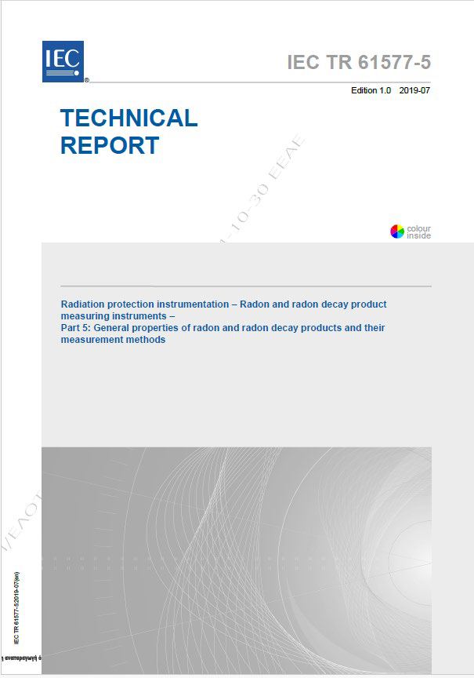
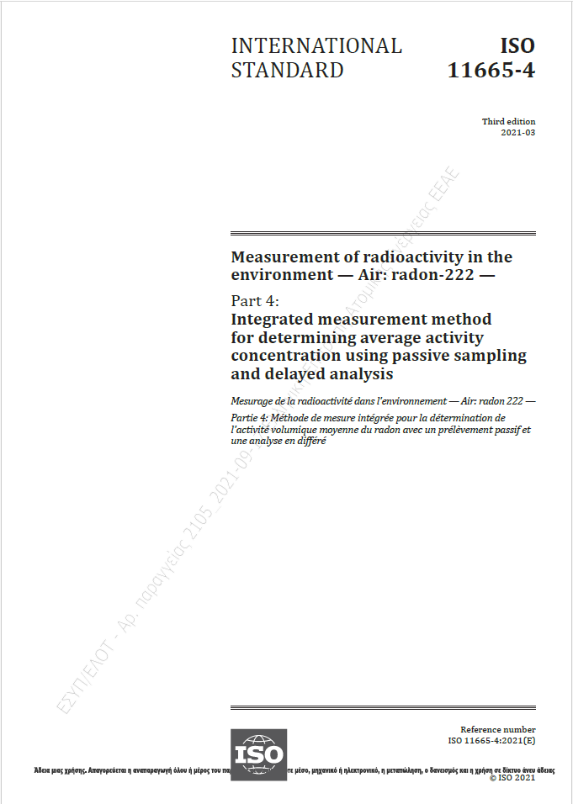
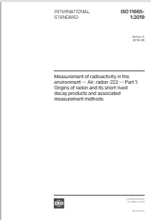
Europian Standards

Slide 13

Regulatory Standard for Indoor Radon Concentration in Georgia
Detector
300 Bq/m³
According to the Government of Georgia’s 2025 Resolution No. 77, the average annual concentration of radon in indoor air must not exceed 300 Bq/m³.
Notes:
Ris mixedvitaa es kanoni sheqmnili da davamato evropashi rogoraa

Slide 14

Mitigation Recommended
If the average annual radon concentration exceeds 300 Bq/m³, protective measures (radon mitigation) must be implemented.

Slide 15
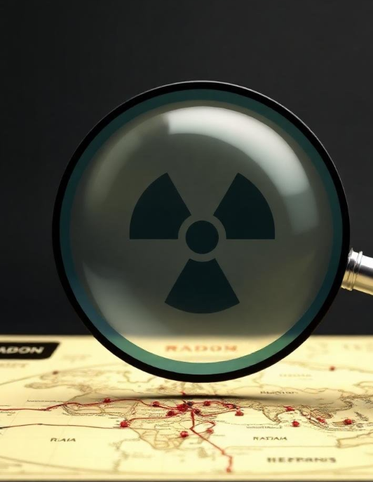
Current Challenges
Limited national data on radon levels, especially in public buildings
Lack of continuous or real-time monitoring systems
Low public awareness about radon risks
Existing radon-related projects are often fragmented or not followed up
Not integrated into broader European monitoring and policy frameworks

Slide 16
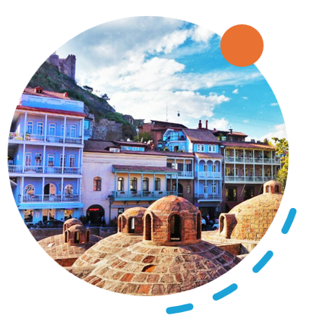
Why Investigate Radon in Georgia?
Geographical Factors:
Georgia is a mountainous country with complex geology, increasing the potential for radon release from the soil and rock.
Hydrogeological Activity:
Presence of artesian waters and sulfur springs (e.g., Tbilisi sulfur baths) indicates active subsurface processes that may enhance radon transport.
Living Conditions:
A significant portion of the population resides in half-basement or ground-level dwellings, which are more vulnerable to radon infiltration.
Public Health Concern
These combined factors suggest a potentially elevated indoor radon risk, making local monitoring and risk assessment essential.

Slide 17


GTU Radon Project
Protecting public health through comprehensive radon monitoring and dosimetry in urban Tbilisi
Three-year project: 2025-2028
Personnel:
  Full-time: 6
  Part-time: 2
Georgian Technical University, Istitute “Talga“
Washington State University
RWTH Aachen University

Slide 18

Project Goals
FY1 – Data Collection & Public Engagement
FY2 – Expansion & Risk Mapping
FY3 – Finalization & Recommendations
Radon concentration testing
Data analysis and quality control
Result analysis & consolidation
Website updates
EU system integration & standardization
Scientific symposia & outreach events
Public Information and education
FY2
FY3
FY1
Notes:
სამწლიანი პროექტია, მოკლე ხნიანი და გრძელ ხნიანი გოპლები გვაქ. ჰელზ ედუქეიშენ

Slide 19
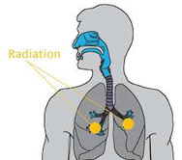
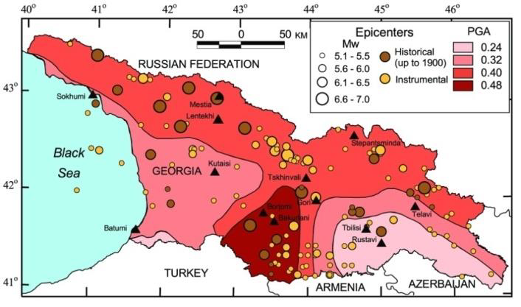
Project Scope
SH-99 map for Georgia from GSHAP project (authors: D. Giardini, G. Gruntal et al.).
Health & Society
Population Health Data
Risk Zones & Vulnerability
Public Awareness
Safety Recommendations
Scientific Research
Geology & Rock Types
Seismic & Radon Maps
Radon Concentration Patterns
Correlation Analysis
Notes:
Figure from Radonschutz Trokenlegung mit IGLU Bauelementen

Slide 20
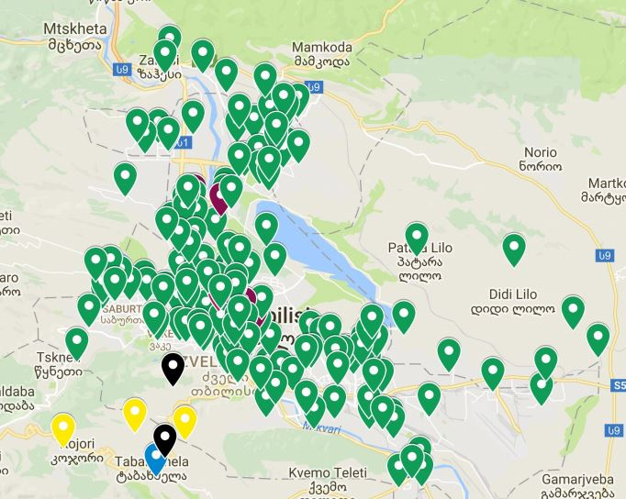
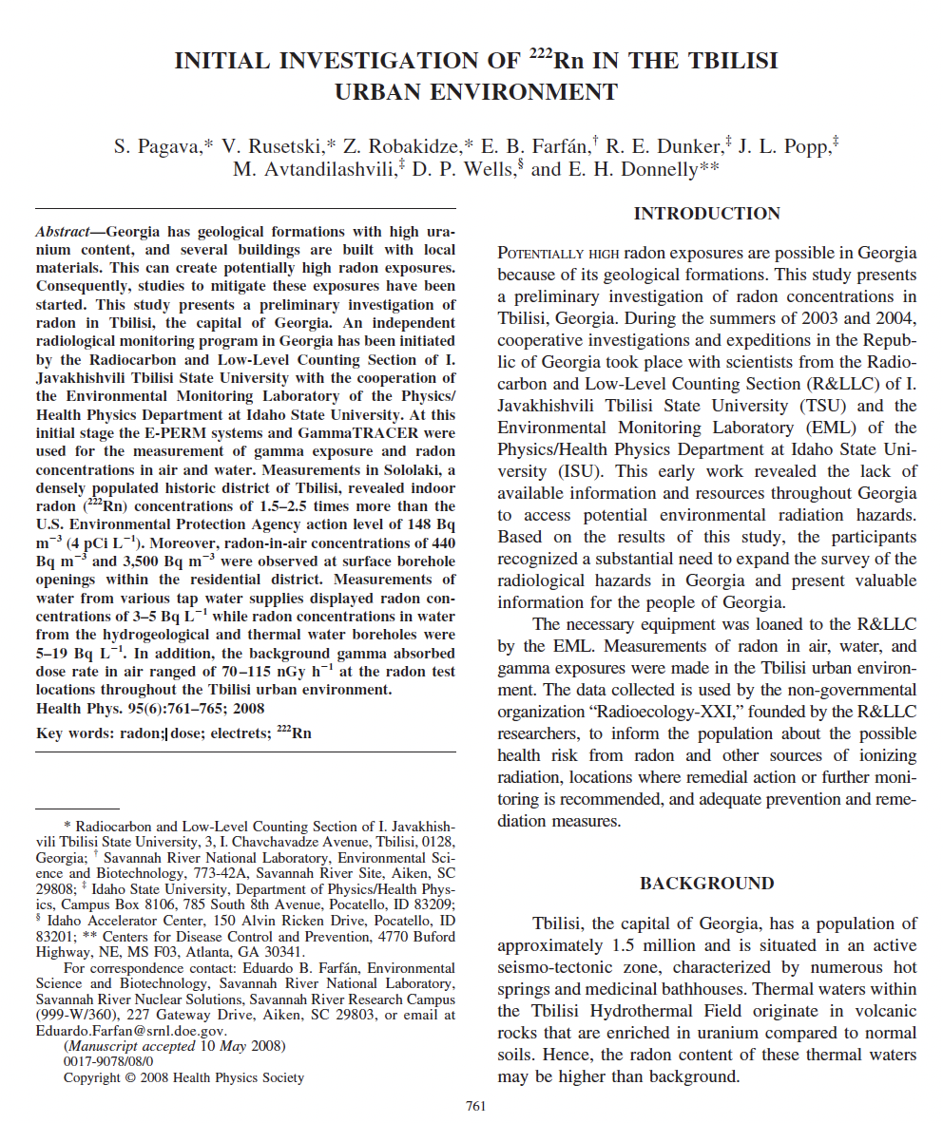
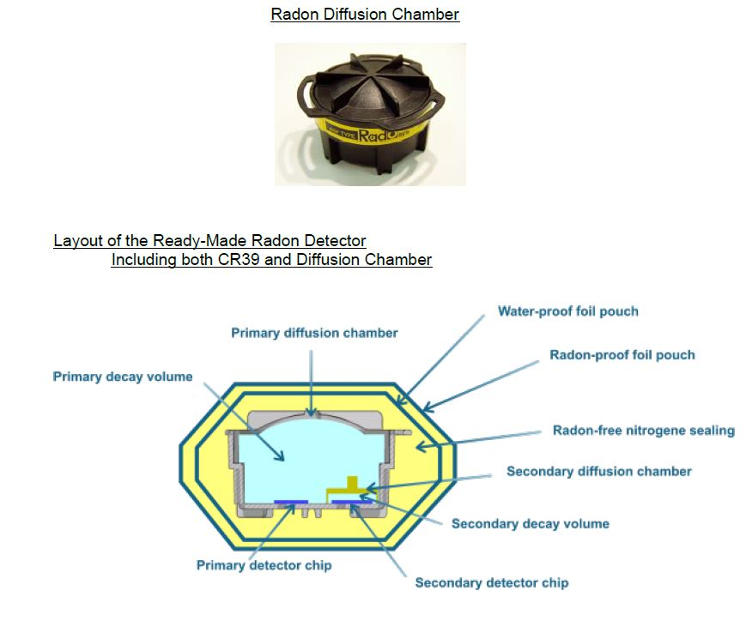
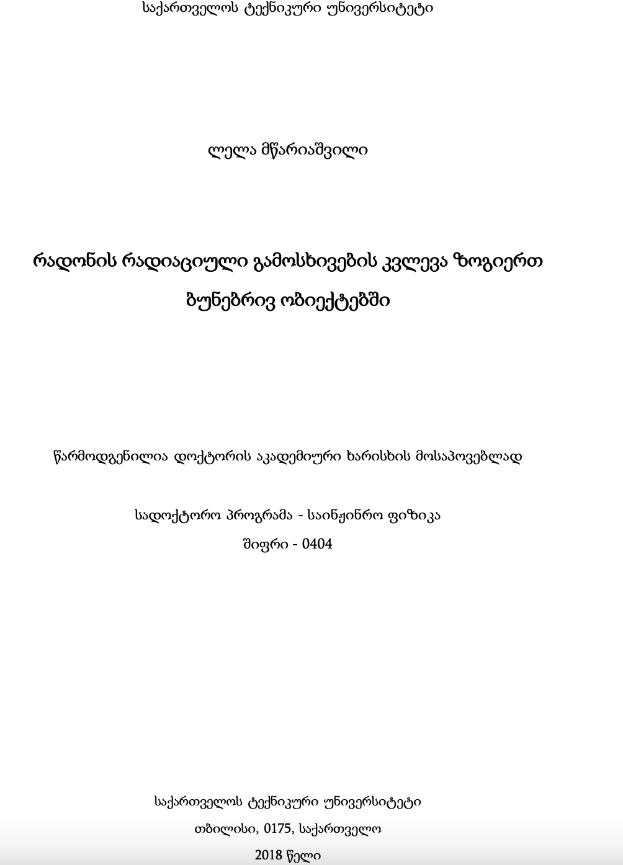
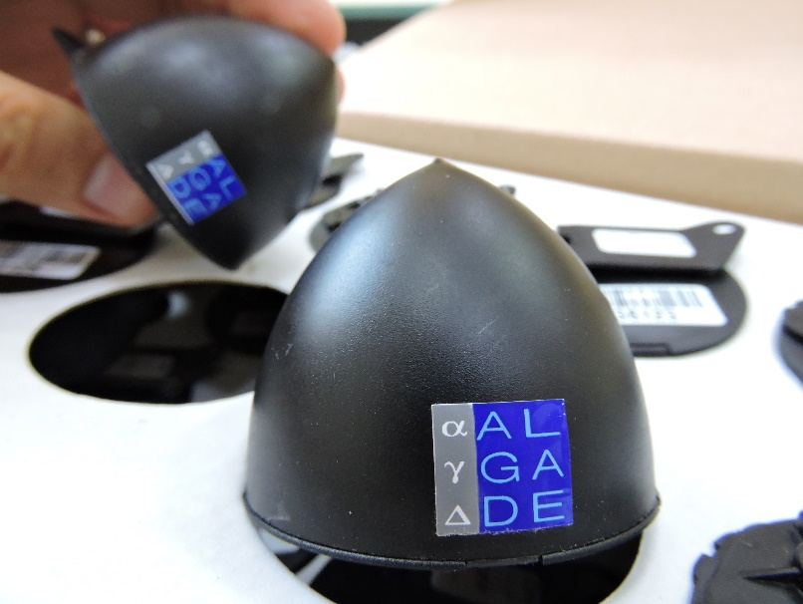
Previous Studies
Development of RadosysTM radon track detectors to Georgia for mapping in 2021
George Melikadze, Hydrogeophysic and Geothermic Research Department, Institute of Geophysics, Ivane Javakhishvili Tbilisi State University
Joined Radon Population Opinion Survey
ALGADE - DPR2
Public Kindergarten mapping using ALGADE (Tbilisi).
159 kindergarten
Feb – Sep 2018
STEAM
PROJECT
Notes:
დეტექტორი რომ შექმენს ვლადიმერი.

Slide 21
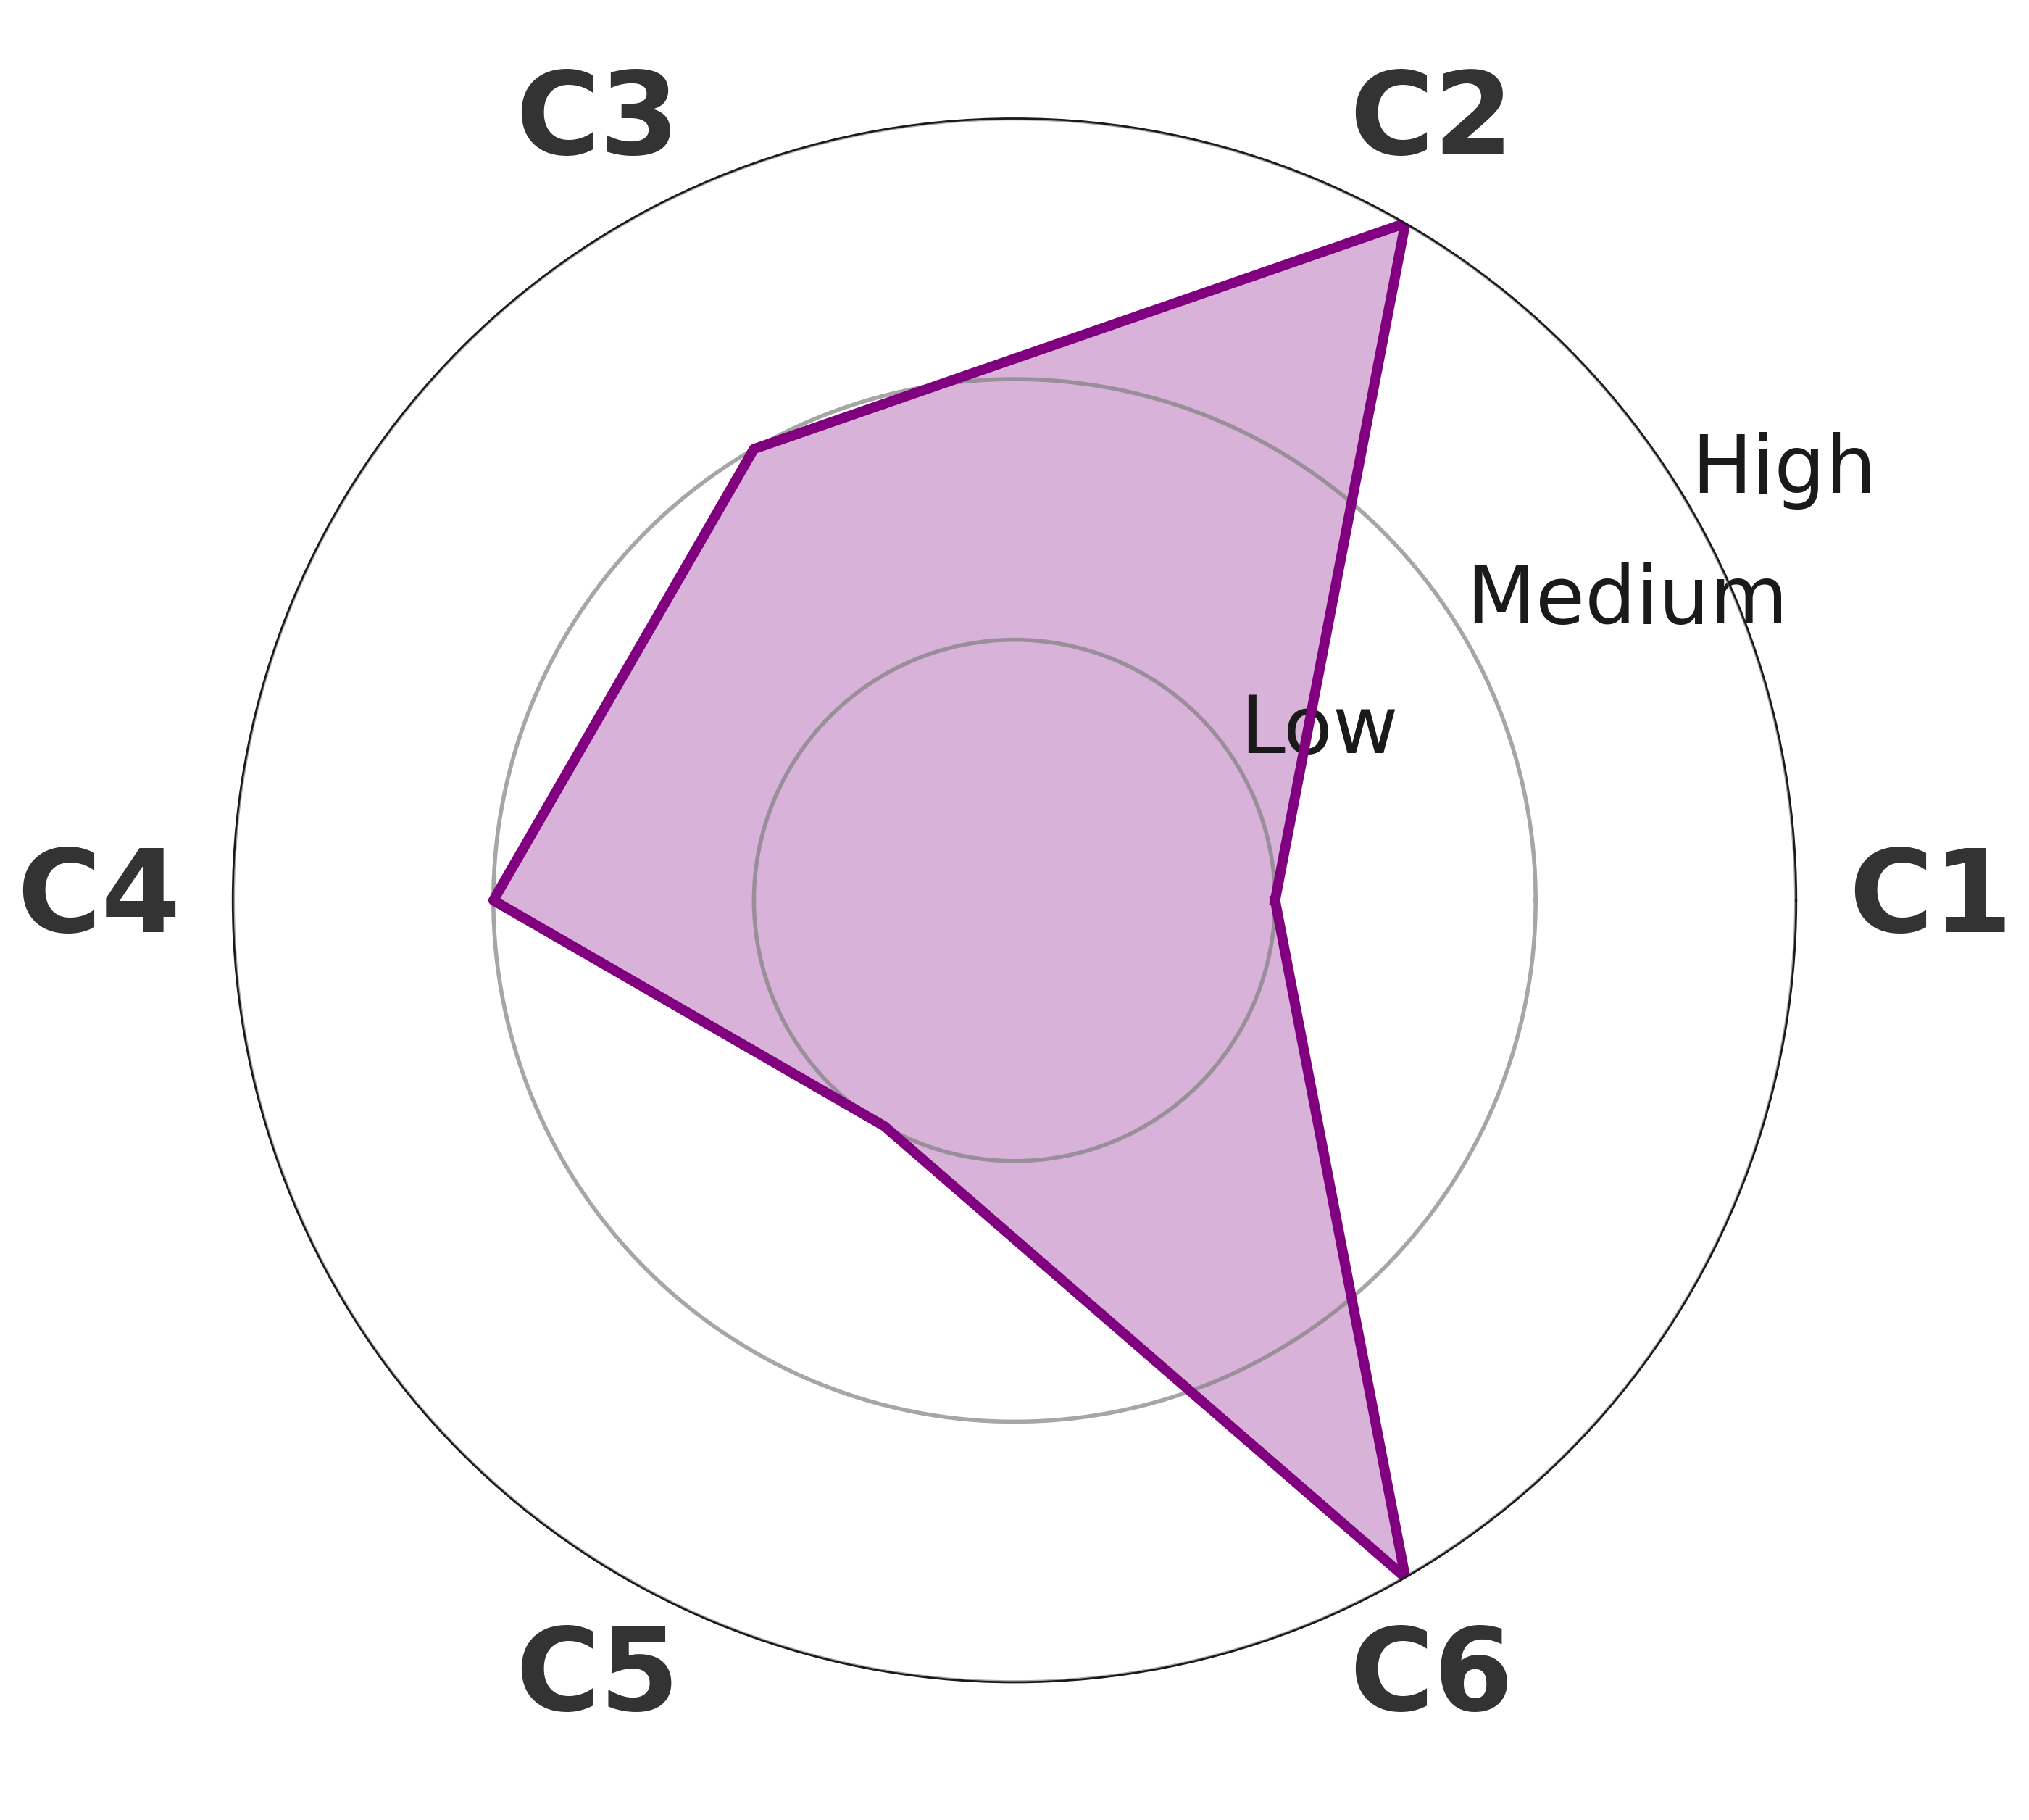
Site Selection: Criteria & Assessment Priorities
Criterion 1: Geological Age of Subsurface Materials
Criterion 2: Soil and Bedrock Composition
Criterion 3: Proximity to Tectonic Structures
Criterion 4: Presence of Wells or Geothermal Discharge Points
Criterion 5: Population and Building Density
Criterion 6: Lack of Historical Radon Monitoring Data
Priority I: high importance
Priority II: medium importance
Priority III: low importance
Notes:
Radon Measurement Site Selection Criteria:
Geological Age of the Underlying Soil and Rock
Priority is given to areas underlain by older geological formations, particularly those known to contain elevated levels of uranium or thorium, which contribute to radon generation.
Soil and Rock Composition
Sites with soil or bedrock rich in granitic, metamorphic, phosphate-bearing, or volcanic lithologies are preferred due to their higher natural radioelement content. Soil permeability and moisture retention characteristics are also considered, as they influence radon mobility.
Proximity to Tectonic Structures
Locations near active or historic fault zones, anticlines, synclines, and other structural features are prioritized due to the potential for enhanced radon migration through fractures and shear zones.
Presence of Wells, Springs, or Geothermal Discharge Points
Areas with boreholes, hot springs, or geothermal manifestations may indicate pathways for deep-origin radon transport and are considered for elevated emission potential.
Population and Building Density
Measurement sites are selected to include both densely and sparsely populated areas, with emphasis on regions where building characteristics (e.g., basements, poor ventilation) may influence indoor radon accumulation and human exposure.
Lack of Historical Radon Monitoring Data
Preference is given to regions that have not been previously surveyed for radon or are underrepresented in existing datasets to improve spatial coverage and identify potential radon-prone zones.

Slide 22
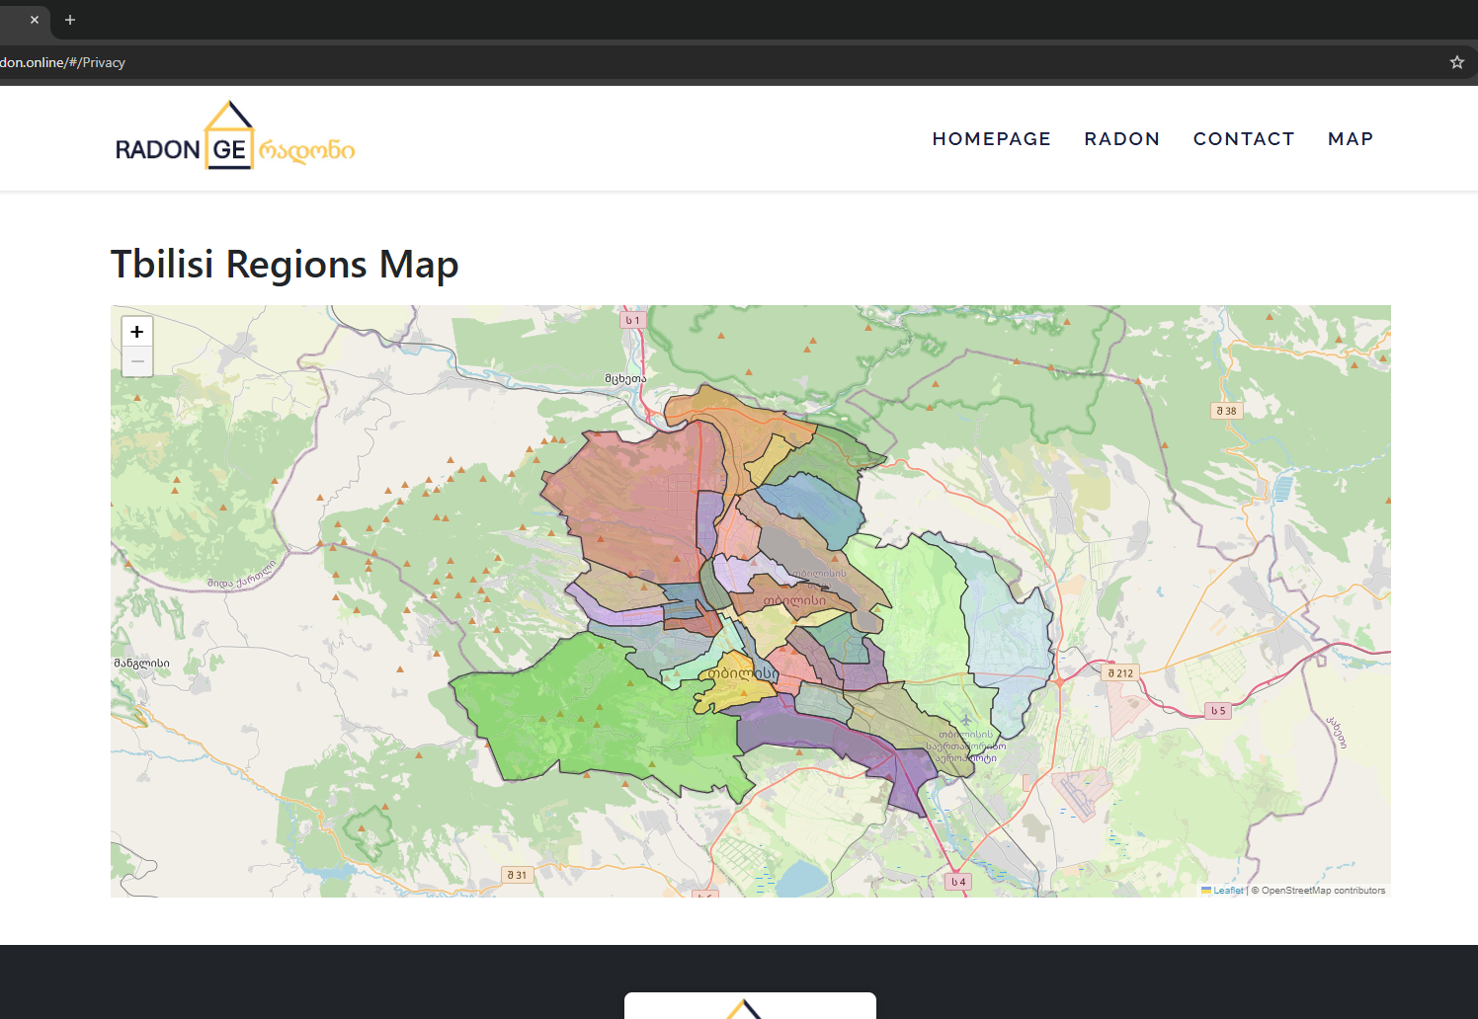
Radon Mapping: Tbilisi
George Melikadze, Hydrogeophysic and Geothermic Research Department, Institute of Geophysics, Ivane Javakhishvili Tbilisi State University
Notes:
Surati rukis (geoologiuri saitis sqrinshoti ubnebad ro aris dayopili) gazombis prioritetebis dadgena moxdeba ubnebis mixedvit gepologiuri rukebis sapudzvelze

Slide 23
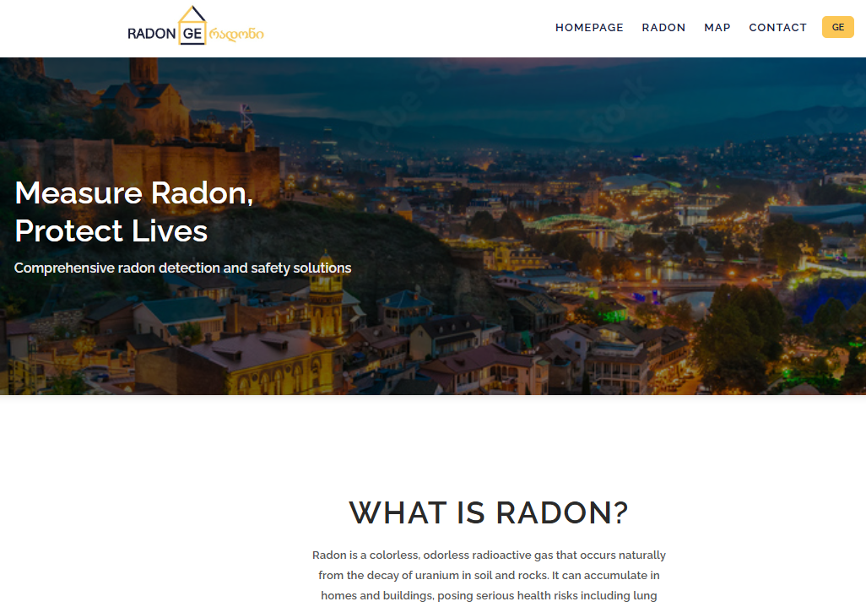
Our Website: radon.ge
About Radon
Public Information
Health Risks
Monitoring Request
Radon Mapping
Mitigation Information
Available in Georgian and English languages
Under development

Slide 24


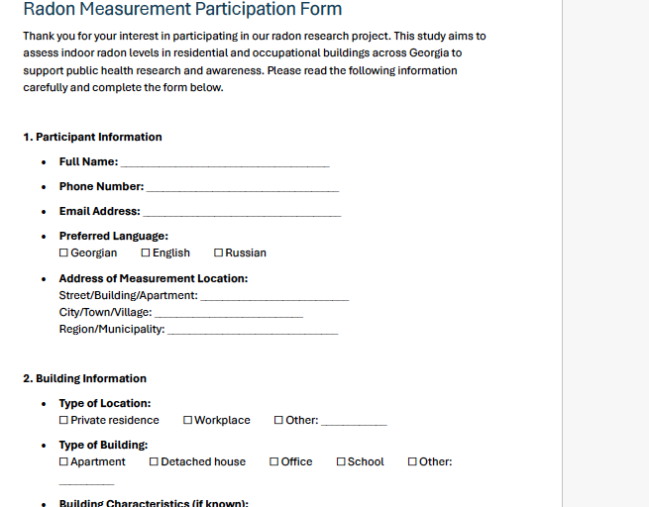
Website: Monitoring Request

Slide 25
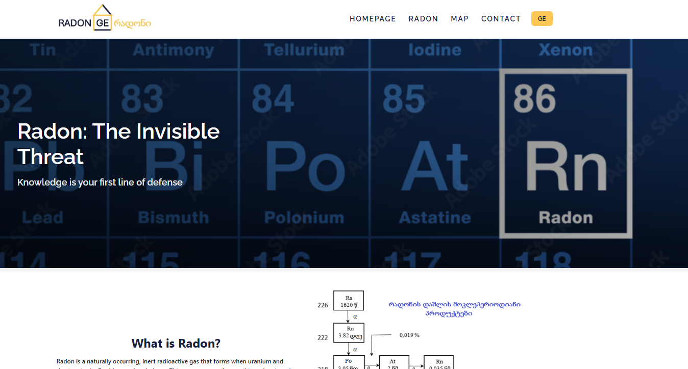

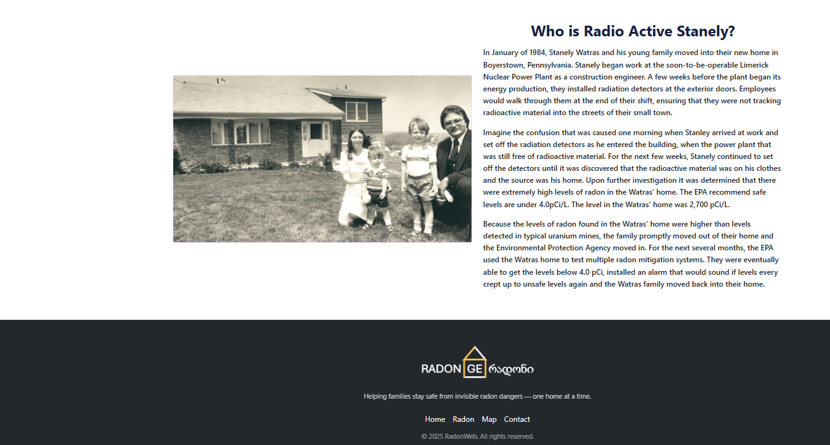
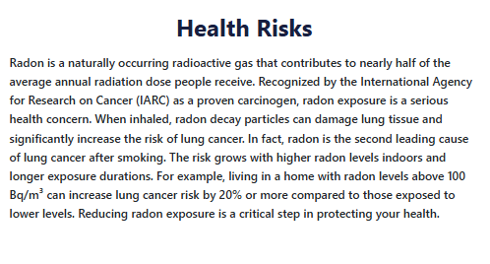
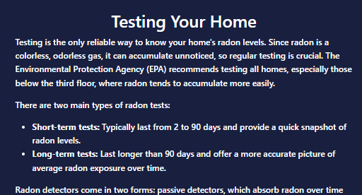
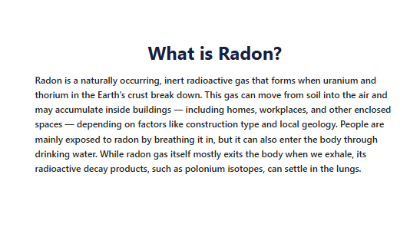
Our Website: Public Education

Slide 26
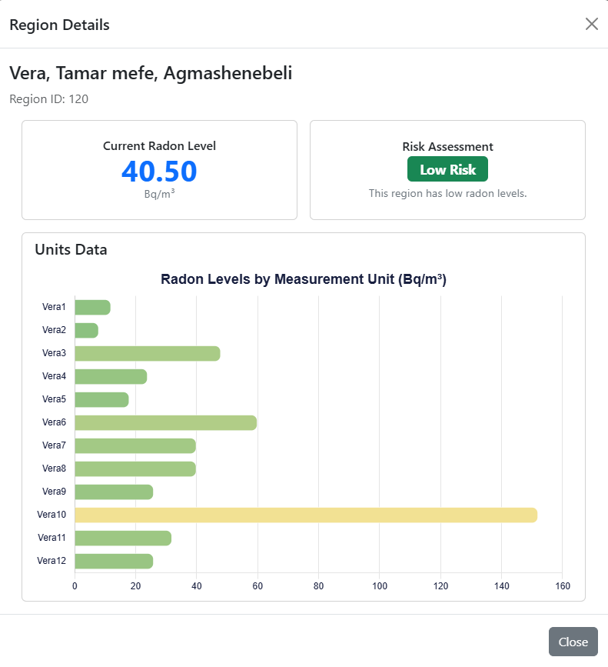
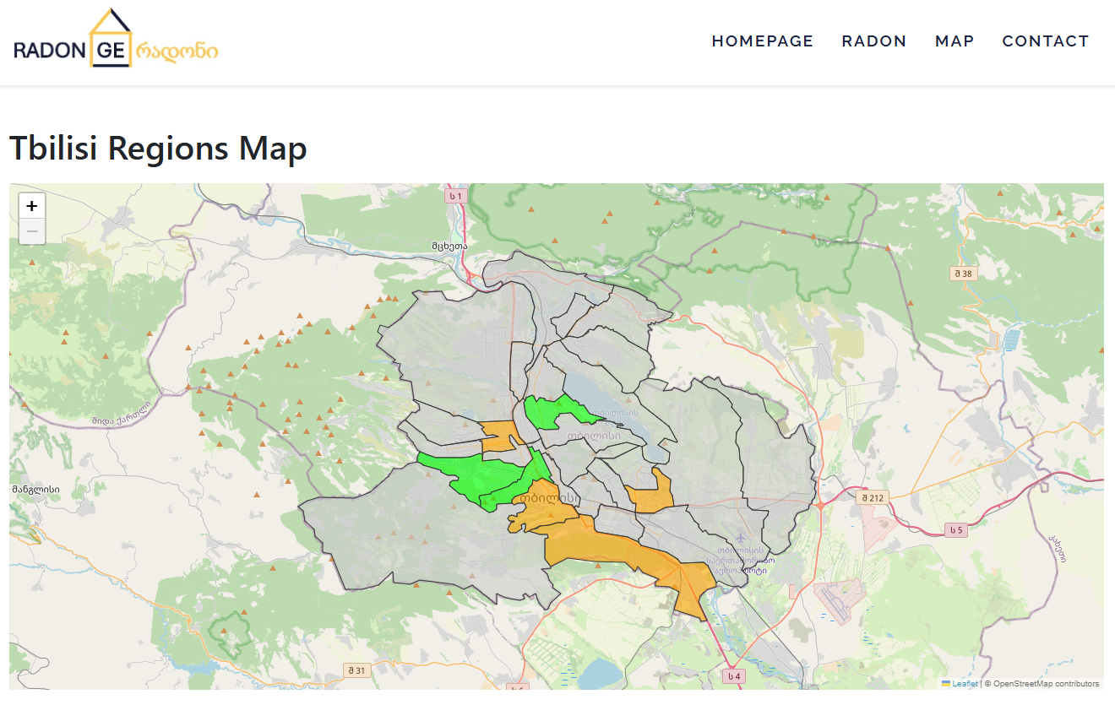
Website: Dissemination of Results

Slide 27

Future Directions: Mitigation
100 ბკ/მ³
400 ბკ/მ³
200 ბკ/მ³
500 ბკ/მ³
50 ბკ/მ³
300 ბკ/მ³
0 ბკ/მ³
Professionally installed radon mitigation systems can
permanently resolve elevated indoor radon levels.
Notes:
Kosultacias mitigacize gavcemt magram mitigacias (jer) ar gavaketebt.

Slide 28
Future Directions
Mitigating radon exposure is essential for health and safety. Our current focus is on introducing technology to support effective monitoring and raise awareness.
When requested, we will consult the public on do-it-yourself (DIY) mitigation options.
Notes:
Orally vtqva eseni

Slide 29

Participate for a Safer, Healthier Future!
Our Website: www.radon.ge
https://institutes.gtu.ge/Institute/3

Slide 30
Thank you!
This work was supported by Shota Rustaveli National Science Foundation of Georgia (SRNSFG), FR-24-2178, Protecting public health through comprehensive radon monitoring and dosimetry in urban Tbilisi

